Slide 1
Meniti Karir Sebagai Data Scientist:
Fundamental Python dan
Big Data Analytics
Hermawan
Wiwit N.
Webinar

Slide 2

Hello
World!
Braga Technologies
Data Scientist
Contact me:
- lil@braga.co.id
- hermawanwiwid
Hermawan
Wiwit N.

Slide 3

Python
Lang
The language's core philosophy
Beautiful is better than ugly.
Explicit is better than implicit.
Simple is better than complex.
Complex is better than complicated.
Readability counts.

Slide 4
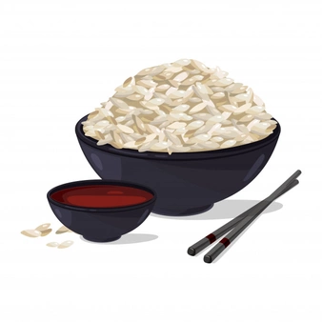

Slide 5
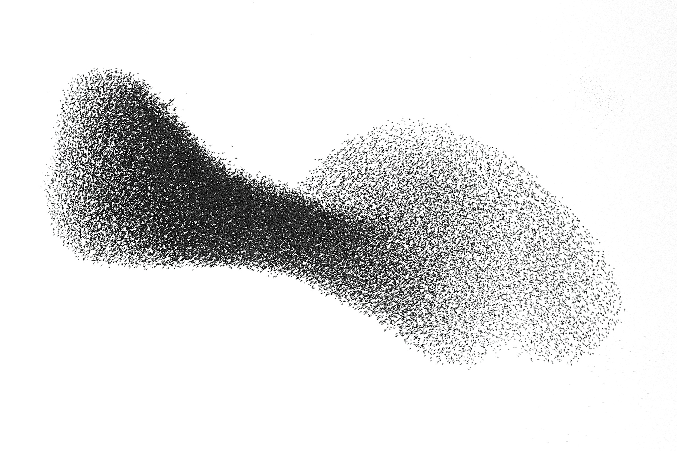

Slide 6
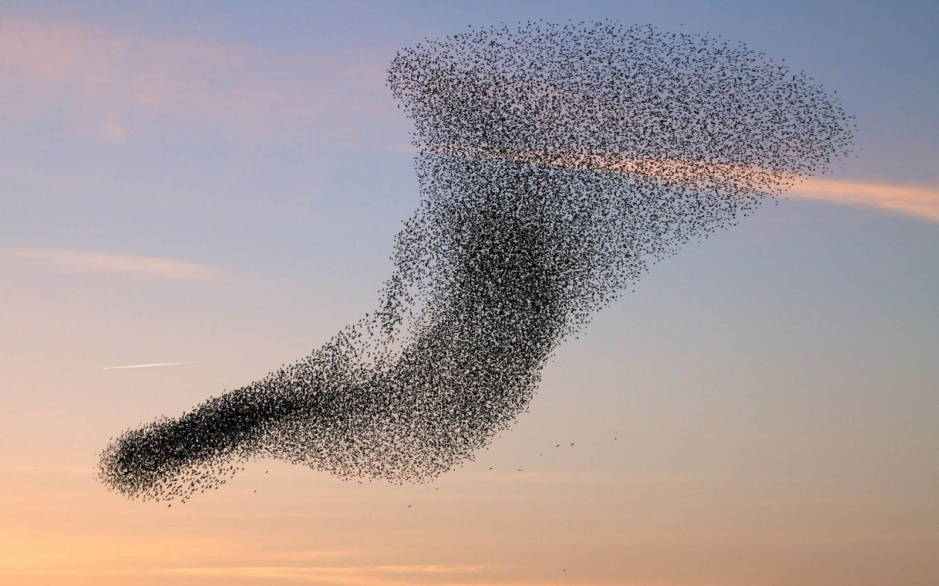

Slide 7
Python
Lang
Web Programming (FastAPI, Django, Flask, Pyramid, Falcon, …)
Scientific and Numeric (SciPy, NumPy, Pandas, …)
AI, ML, Deep Learning (Sklearn, Tensorflow, Keras, ...)
GUI Dev (wxPython, tkInter, PyGtk, ..)
Software Dev (Buildbot, Trac, ..)
System Adm (Ansible, Salt, ..)
Embeded Computing (RaspPi, MicroPython, …)
Education (Turtle, Robotics, ..)

Slide 8
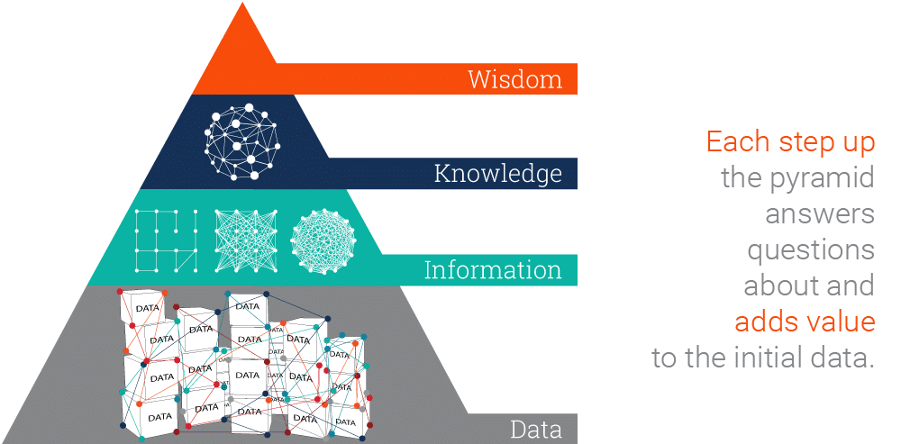
Data
Scientist
“
We turn the knowledge and insights from the data into a learning experience that guides our actions.”

Slide 9
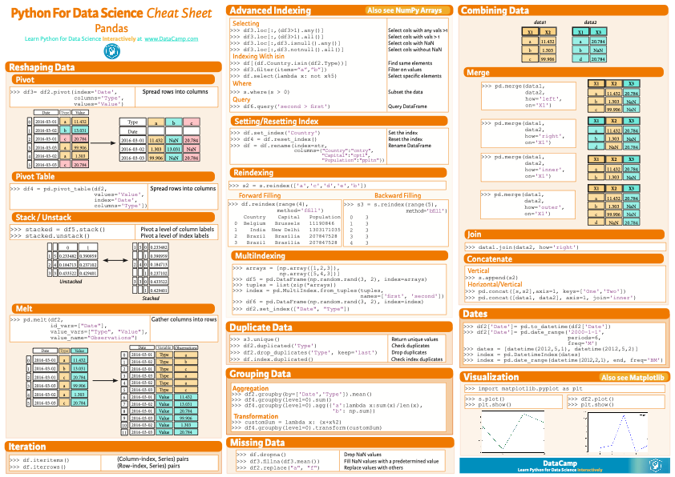
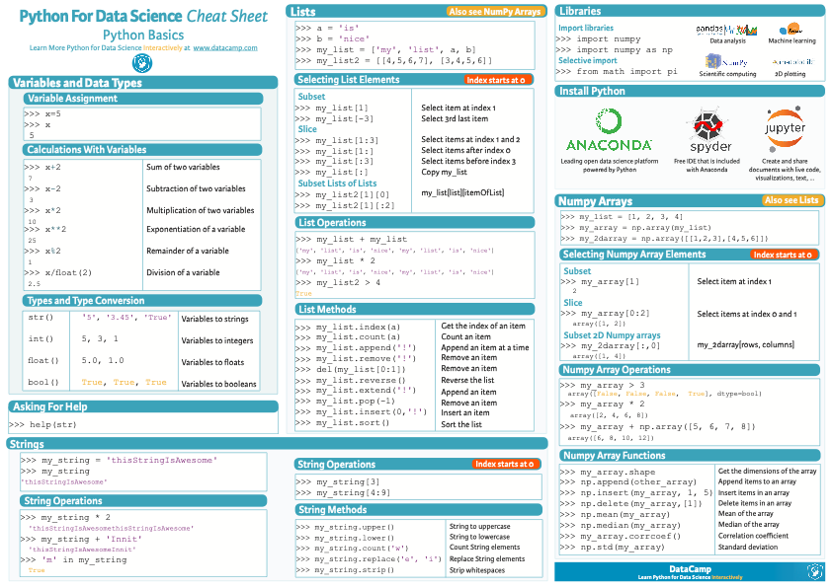
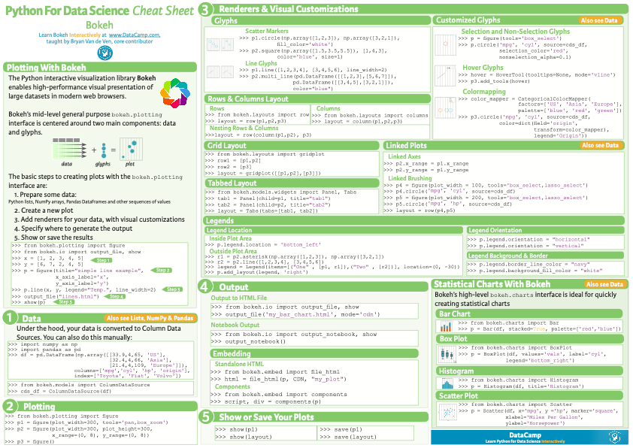
Python
Basics
[In:] Print(“Hello World!”)
https://drive.google.com/drive/folders/18nEHMFYZ24IHMviRIqewGo9u7MxVYPw7?usp=sharing

Slide 10
Python
Pandas
[In:] pd.read_csv(“file.csv”)
https://drive.google.com/drive/folders/18nEHMFYZ24IHMviRIqewGo9u7MxVYPw7?usp=sharing

Slide 11
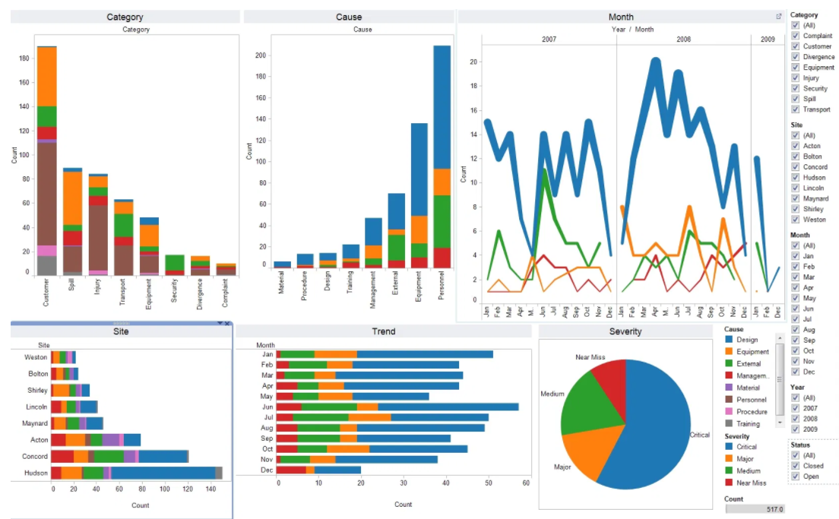
Python
Matplotlib
[In:] plt.plot()
https://drive.google.com/drive/folders/18nEHMFYZ24IHMviRIqewGo9u7MxVYPw7?usp=sharing

Slide 12
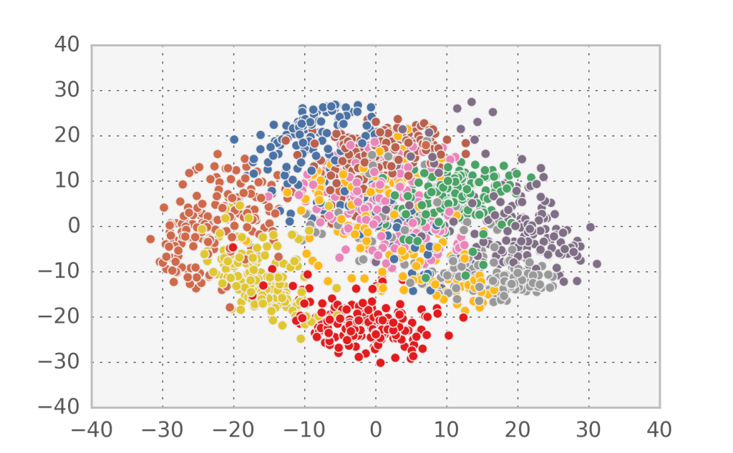
Python
Sklearn
[In:] regr.predict()
https://drive.google.com/drive/folders/18nEHMFYZ24IHMviRIqewGo9u7MxVYPw7?usp=sharing

Slide 13
Thank
You

